Slide 1
Software Engineering Economics Tool - Technical Overview
Group Members：
24129061 Tiago
24121434 彭超
24129097 Damien
24129057 Alan
2025/06/12

Slide 2
PPT模板 http://www.1ppt.com/moban/
1
Frontend Framework & Technologies
CONTENTS
2
Algorithms Used for Economic Analysis
3
Achievements Display

Slide 3
Frontend Framework & Technologies
PART 01
Notes:
模板来自于：第一PPT https://www.1ppt.com/

Slide 4
Frontend Framework & Technologies
Next.js 14 with React 18 - Modern full-stack React framework
TypeScript - Type-safe development with enhanced code quality
Tailwind CSS - Utility-first CSS framework for responsive design
Component-based Architecture - Modular, reusable UI components

Slide 5
Development Approach
Interactive Web Application - Real-time calculations and visualizations
Responsive Design - Mobile-first approach with gradient backgrounds
State Management - React hooks (useState) for dynamic data handling
Modular Structure - Separate modules for each economic analysis type

Slide 6
Algorithms Used for Economic Analysis
PART 02

Slide 7
Cost Estimation Module
COCOMO (Constructive Cost Model)
Organic, Semi-detached, and Embedded project modes
Effort = a × (KLOC)^b × EAF
Duration = c × (Effort)^d
Team Size calculation based on effort and duration
Function Points Analysis
Weighted calculation of system components
External Inputs/Outputs, Internal Files, External Interfaces
Complexity adjustment factors
LOC estimation from function points

Slide 8
Budgeting & Financial Analysis
ROI (Return on Investment)
ROI = ((Total Cash Flows - Initial Investment) / Initial Investment) × 100
NPV (Net Present Value)
NPV = Σ(Cash Flow_t / (1 + r)^t) - Initial Investment
Discount rate consideration for time value of money
IRR (Internal Rate of Return)
Newton-Raphson iterative method
Finding rate where NPV = 0
Payback Period
Cumulative cash flow analysis
Break-even point calculation

Slide 9
Risk Management
Sensitivity Analysis
Variable impact assessment on project outcomes
Range-based scenario modeling
Monte Carlo Simulation
Statistical modeling with multiple iterations (1000+ runs)
Normal and uniform distribution support
Risk probability calculations

Slide 10
Achievements Display
PART 03

Slide 11
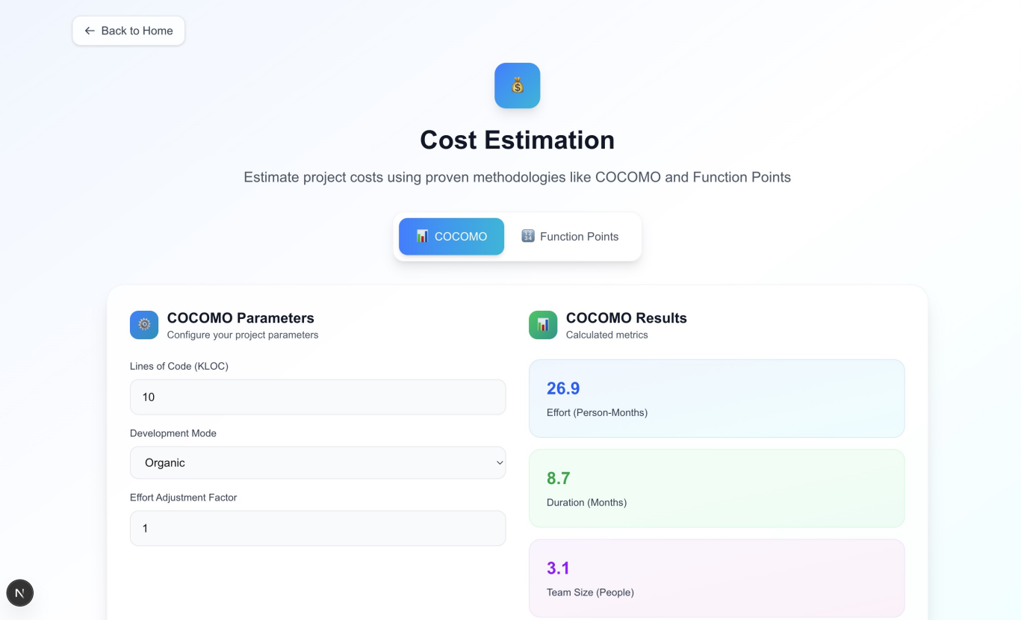
Achievements Display
Cost Estimation Module

Slide 12
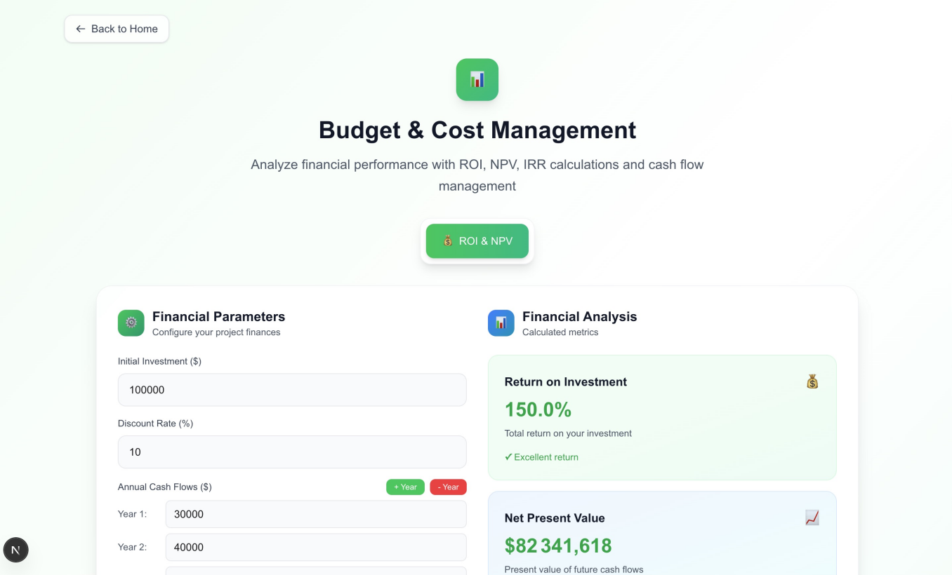
Achievements Display
Budget & Cost Management

Slide 13
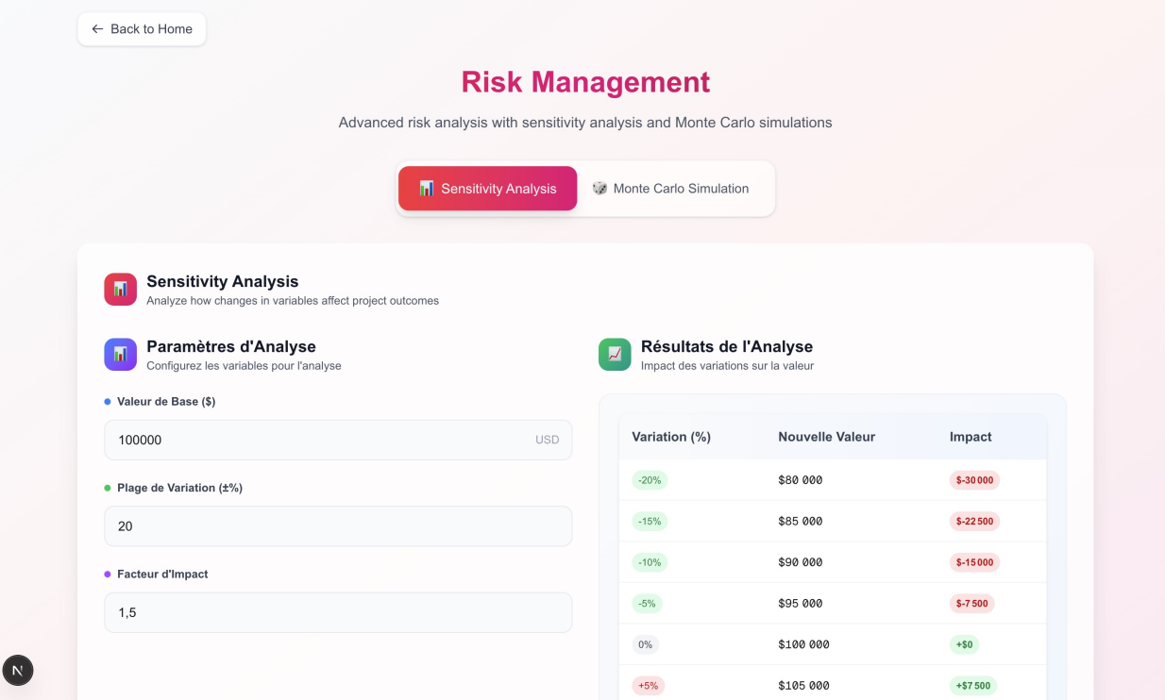
Achievements Display
Risk Management

Slide 14

Achievements Display
Allocation des Ressource

Slide 15
THAKNS
2025/06/12

